Slide 1
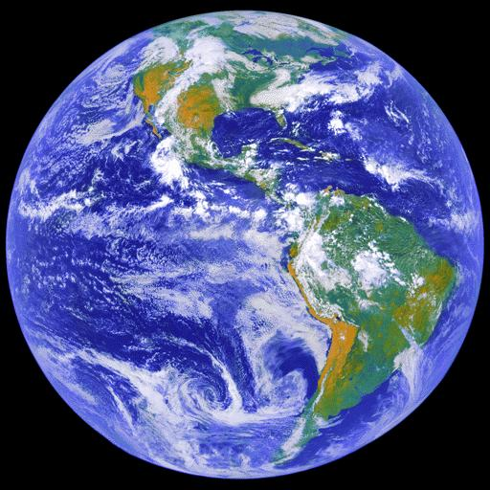

INTRODUCTION TO PHYSICAL GEOGRAPHY:
Chapter 1 The “spheres” of Earth
Hydrosphere
Lithosphere
Atmosphere
Biosphere
Click on audio icon:

Slide 2
Lines of latitude to know*:
Equator (O°) starting point to number parallels
Tropic of Cancer (23.5° N)
Tropic of Capricorn (23.5° S)
Arctic Circle (66.5° N)
Antarctic Circle (66.5° S)
45° N (our latitude)
*we will explain their significance later

Slide 4
Geographic Information Systems (GIS)
GIS is defined as any system which facilitates the analysis of multiple layers of spatial data (maps of specific themes)

Slide 5
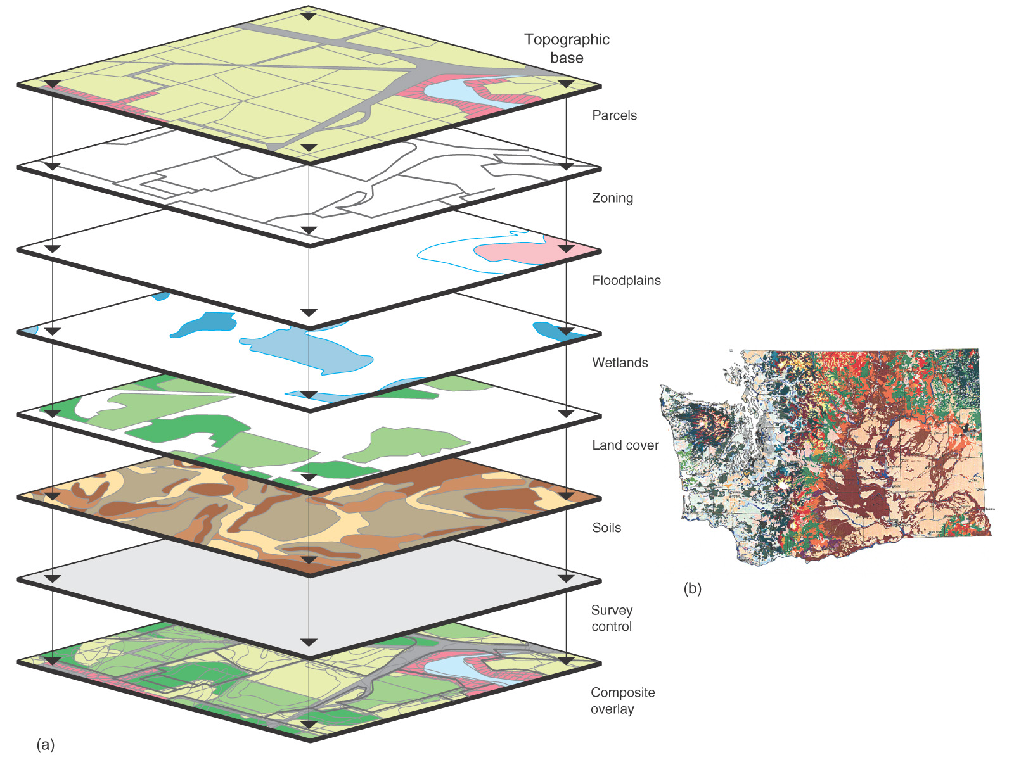
GIS System
Figure 1.23

Slide 6
The Science of Geography
Geography is
  methods, not just a body of knowledge
  holistic
  eclectic

Slide 7
Geography is:
The science that studies the relationships among
  natural systems,
  geographic areas,
  societies,
  cultural activities,
  and the interdependence of all of these over space.

Slide 8
Physical Geography is
The spatial analysis of all the physical elements and processes that make up the environment.

Slide 9
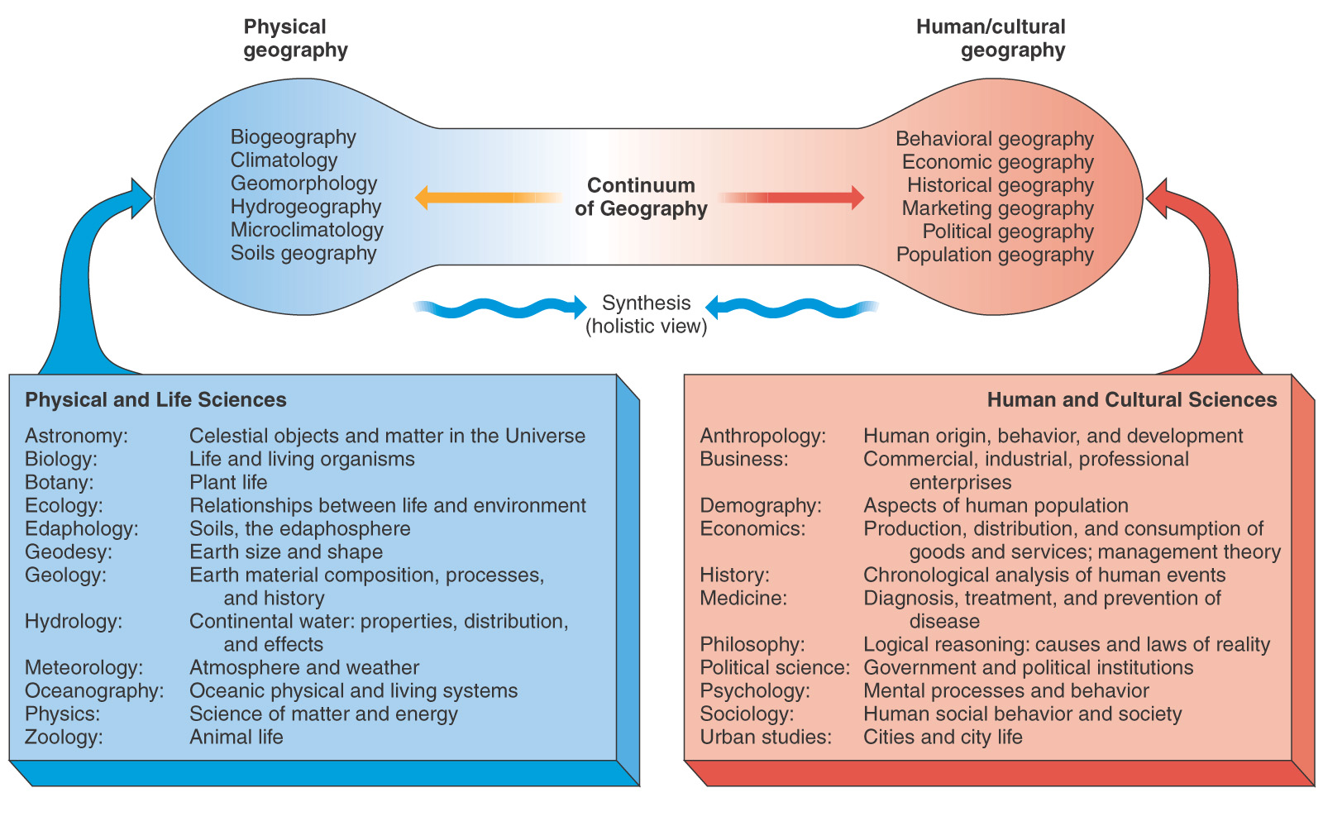
Figure 1.2

Slide 10
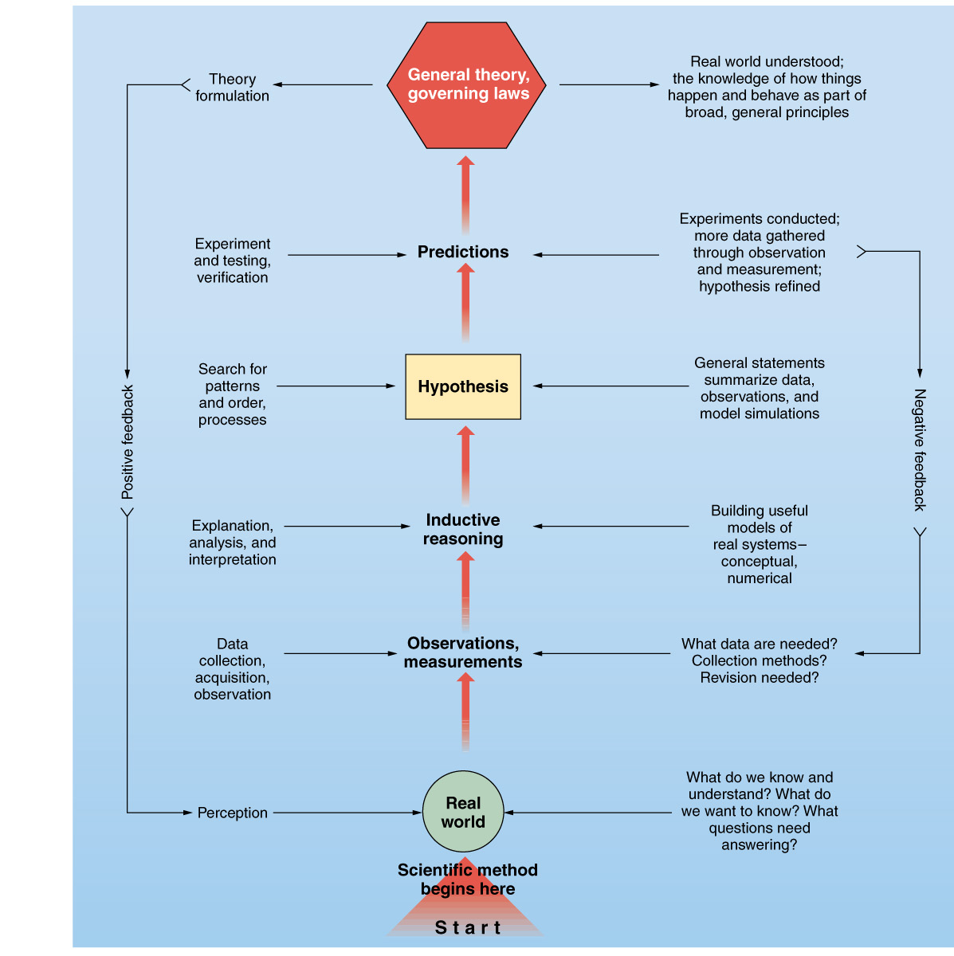
Physical geographers use scientific methods:
prediction
explanation
observation
Example of carbon dioxide’s ability to trap heat in the atmosphere: read part 1 of this link- https://www.co2.earth/1820-1930-fourier-to-arrhenius
Listen to the audio embedded below after you look at the link material above.
Figure 1

Slide 11
Earth Systems Concepts
System: an ordered, interrelated set of things & their attributes, linked by flows of energy & matter, that is distinct from the surrounding environment
Open systems have inputs and outputs of energy and matter
System feedback: when outputs influence continuing system outputs via feedback loops. Example of ice-albedo feedback:
System equilibrium: when rates of inputs and outputs are equal and amounts of energy and matter in storage are fairly constant

Slide 12
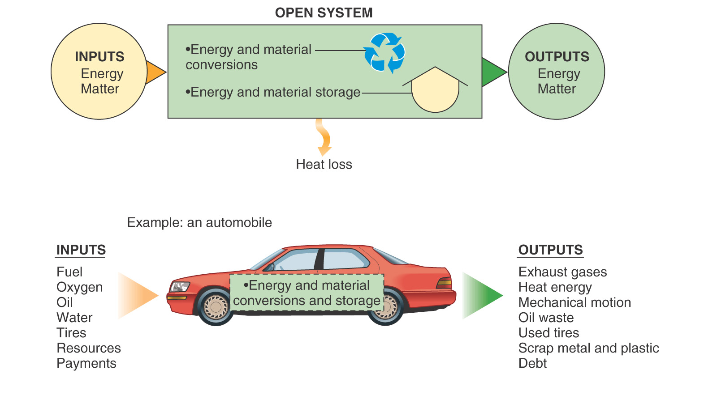
Figure 1.3

Slide 13
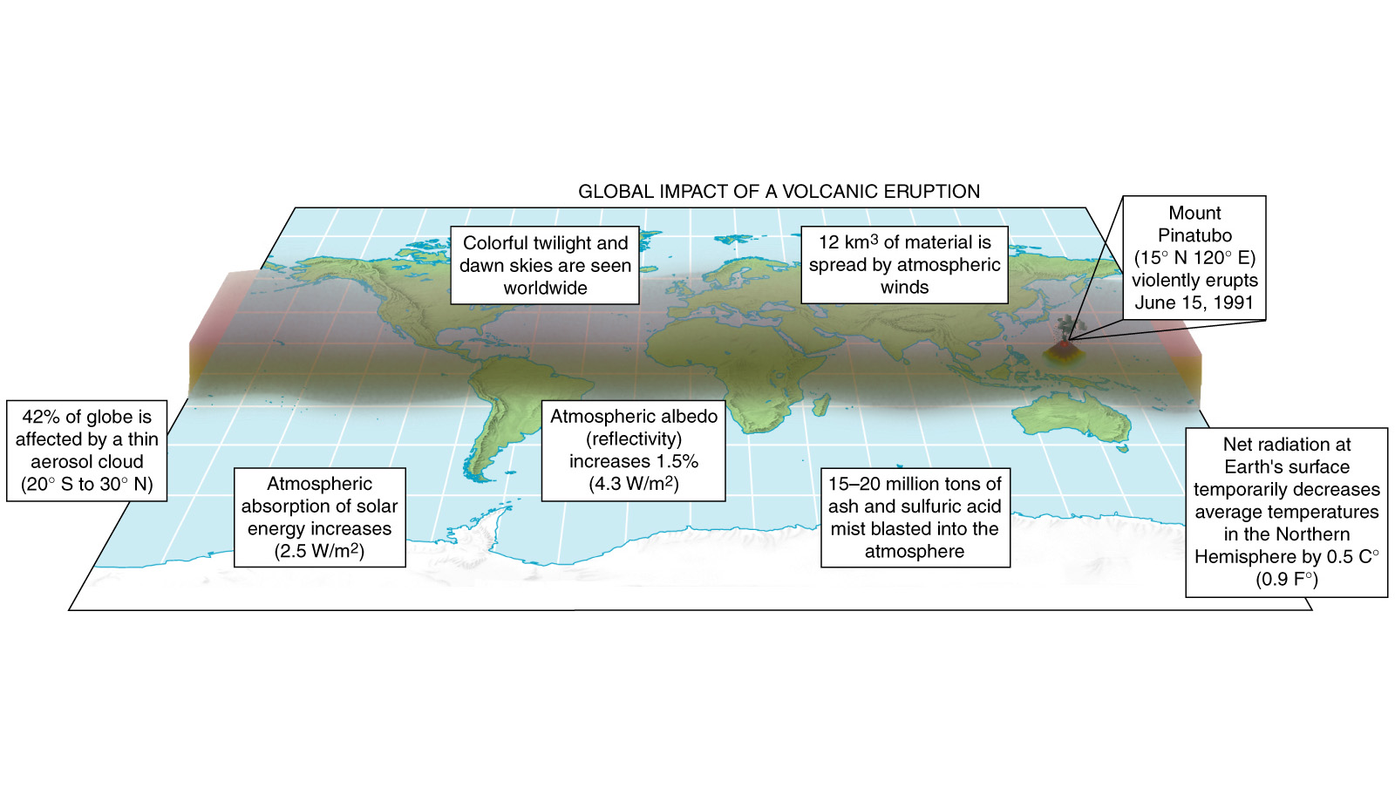
Global Effects of
Mount Pinatubo
Figure 1.5

